Slide 1
Digital Interfacing

Slide 2
Intel 8255 PPI
I/O port chip used for interfacing I/O devices with microprocessor.
Very commonly used peripheral chip which is available on 8086 motherboard.
Acts an interface between the peripheral device and the 8086.
Has 3 i/o ports namely port A,port B,port C to transfer parallel data,each of 8 bit.
Port C is used as 2 4-bit ports(independent halves) or to produce handshake signals for A and B.
I/O signals classified into 2 groups
Group A: PA7-PA0 and PC4-PC7
Group B : PB7-PB0 and PC0-PC3

Slide 3
Methods of Passing Parallel Data
4 methods
a)Simple i/o
b)Simple strobe
valid data will be present on an external device only at certain
time,so it must be read at that time.
Ex:When a key is pressed,circuit in keyboard sends out corresponding ASCII code on 8 parallel data lines and sends a strobe signal on another line to indicate valid data is present on data lines.
For high speed data transfer,the sender will send data bytes faster than receiving system could read them.
Hence handshake scheme is used.

Slide 4
c)Single Handshake I/O(Strobed I/O)
Peripheral device outputs some parallel data and send STB’
signal to MP.
MP detects STB’ signal and sends ACK to peripheral to indicate data has been read and peripheral can sent next byte of data.
Handshaking ensures that peripheral device does not send data until receiving system indicates with an ACK that it is ready to receive next byte.
d)Double Handshake I/O
The sender asserts STB’(low) and the receiver raises its ACK.
The external device then send data byte and raises its STB’ and receiver reads the data and drop ACK.

Slide 5
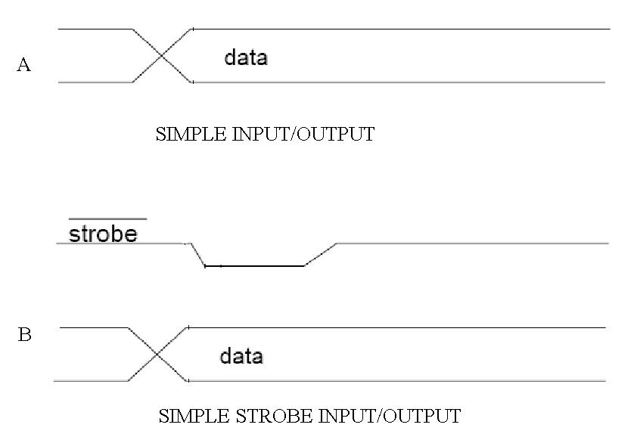

Slide 6
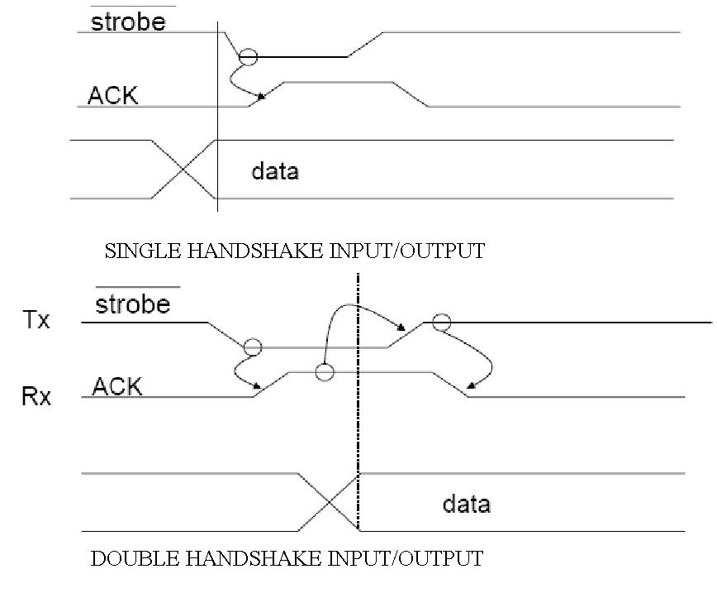

Slide 7
HANDSHAKE INPUT DATA TRANSFER SIGNAL DIRECTIONS
MICRO-
PROCESSOR
PORT
DEVICE
PERIPHERAL
PARALLEL
DATA LINES
STB
ACK

Slide 8
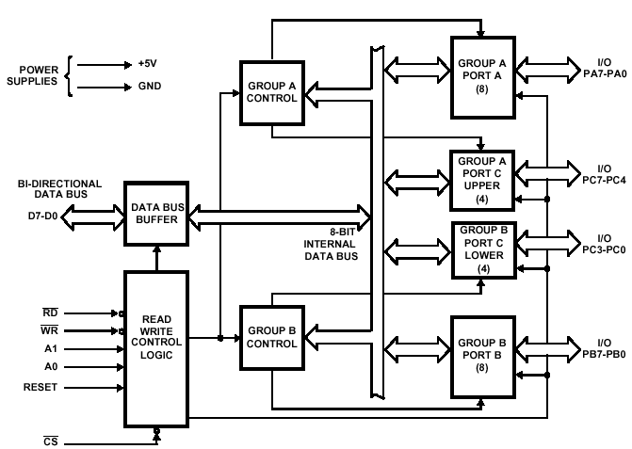
8255 block diagram

Slide 9
8255 Operational Modes
a)Mode 0: Simple Input or Output
Ports A, B are used as two simple 8-bit I/O ports,port C as two 4-bit ports.
Each port can be programmed to function as simply an input port or an output port.
Ports don’t have handshake or interrupt capability.
If both port A and B are set to mode 0,then 2 halves of port C
can be used together as an additional 8-bit port.

Slide 10
b)Mode 1: Input or Output with Handshake
handshake signals are exchanged between the MPU and peripherals prior to data transfer.
The features of the mode include the following:
Two ports (A and B) function as 8-bit I/O ports.They can be configured as either as input or output ports.
Each port uses three lines from port C as handshake signals.
The remaining two lines of Port C can be used for simple I/O operations.

Slide 11
c)Mode 2: Bidirectional Data Transfer
used primarily in applications such as data transfer between two computers.
Port A can be configured as the bidirectional port,Port B either in Mode 0 or Mode 1.
Port A uses five signals from Port C as handshake signals for data transfer.(PC3-PC7)
The remaining three signals from port C can be used either as
simple I/O or as handshake for port B.
Only portA can be initialized in this mode.

Slide 12
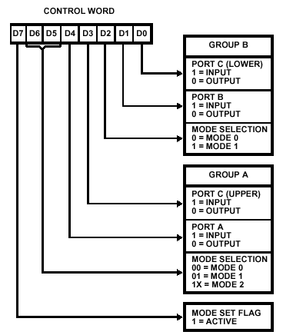
8255 control word format

Slide 13
1.Display Interfacing
data segment
base_address equ 0c800h
porta equ base_address+00h
portb equ base_address+01h
portc equ base_address+02h
control equ base_address+ 03h
fire db 0,0,79h,50h,06h,71h
data ends
code segment
assume cs:code,ds:data
start : mov ax,data
mov ds,ax
mov al,80h
mov dx,control
out dx,al
disp1: mov di,1000
dispfire: mov si,offset fire
call display
call delay
dec di
jnz dispfire
call delay
mov al,0bh
int 21h
or al,al; cmp al,’ff’
jz disp1 ; jnz disp1
mov ah,4ch
int 21h
display proc near

Slide 14
mov dx,portc
mov al,07h;to erase previous data
out dx,al
;mov cx,06h
mov bl,00
disp2 :mov al,bl
mov dx,portc
out dx,al
mov dx,porta
lodsb
out dx,al
call delay
inc bl
cmp bl,05
jle disp2
ret
display endp
delay proc near
mov cx,0fff1h
l1:dec cx
jnz l1
ret
Delay endp
code ends
end start

Slide 15
2.Logic Controller Interfacing
data segment
base_address equ 0c800h
porta equ base_address +00h
portb equ base_address +01h
portc equ base_address +02h
ctrl equ base_address +03h
data ends
code segment
assume cs:code, ds:data
start: mov ax,data
mov ds,ax
mov dx,ctrl
mov al,82h ; pa o/p port,pb i/p
out dx,al
rpt: mov dx,portb
in al,dx
cmp al,1
jae dispff
mov dx,pa
mov al,00
out dx,al
jmp delay
dispff: mov dx,porta
mov al,0ffh
out dx,al
delay: mov cx,0fff1h
lp: dec bx
jnz lp
mov ah,0bh
int 21h
or al,al
jz rpt
Mov ah,4ch
Int 21h

Slide 16


